Slide 1
USAID Zambia Evidence For Health (E4H)
PRESENTATION ON SELECTED COVID-19 related INDICATORS - DHIS2 data
Zambia Evidence for Health Project
Dec, 2020

Slide 2
Objective of this presentation
The E4H activity will:
Continue to support routine data analysis of FH indicators
Assess health service provision for selected services during the COVID-19 pandemic period
Find out measures are put in to address identified issues
* All the data presented here is from MoH DHIS 2 platform

Slide 3
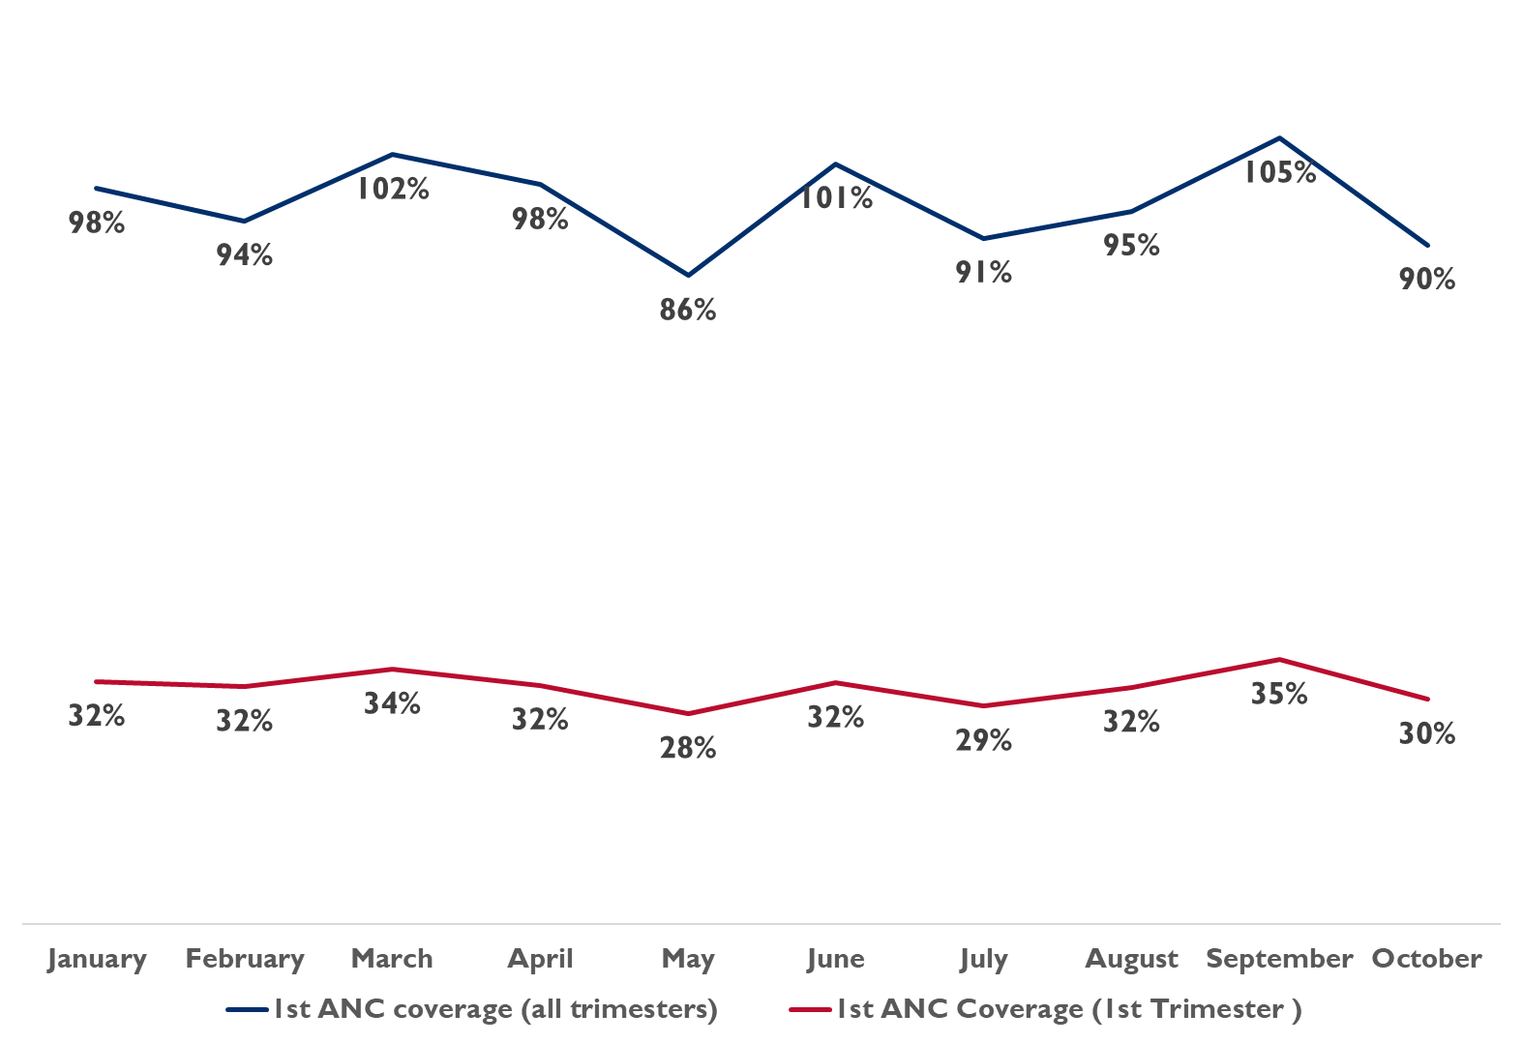
1st ANC coverage from Jan 20 to Oct 20
On average 1st ANC coverage for all Trimesters has been around 96%
May 2020 recorded the lowest of about 86% ANC coverage
1st ANC Coverage (1st Trimester) has been around 32% on average
No apparent attribution of COVID-19 to 1st ANC Coverage
Notes:
Feedback (note some comments are general and relate to more than just this slide):
-Can you link the graphics to the data set/table so that we can easily cross-reference what is here and what is in the excel file? Or is this something that will be able to be done in the data model?
-Please include the indicator definition and/or numerator/denominator within the slides or within the comments. While this information is available in a word document that you shared with us, having this side by side will reduce back and forth between documents and reduce possible errors in understanding. Note: I tried to calculate some of these indicators at the province level using the excel file, but my national numbers did not always match up with what was on the slide so it became very frustrating as I was not always clear how things were calculated and could not confirm the figures.
-While the visual of this graph is nice, it isn’t super helpful. COVID-19 arrived in Zambia in Q1 2020 so it has been in Zambia for almost the entire coverage of the line graph. It would be helpful if this could be compared to trends in 2019 and/or 2018 as well so we can see if it is increasing/decreasing over previous years. For some indicators we also see spikes in certain months linked to activities (child health weeks, etc) and having trends over years would point these out as well.
-National data is great, but we also really need more visuals and details on provincial data (this is a general comment, I noted this slide is followed by a slide that looks at provinces). We look at figures from provinces on a regular basis to show the impacts of our investments and also determine where to focus our efforts. We often need to compile these figures quickly to meet reporting needs so having them quickly and easily accessible is key. Additionally, we also often need to have this data over two or more years so that we can show what the increase/decrease over time has been.
-Is there any indicator of why May 2020 may have had the lowest ANC coverage rate? It seems like a substantial dip given that April and June are both fairly high.
-Please indicate some reasons why some figures may be over 100%. Are these figures potentially linked to border towns receiving children from other countries for ANC visits, potential issues with denominator figures, other?

Slide 4
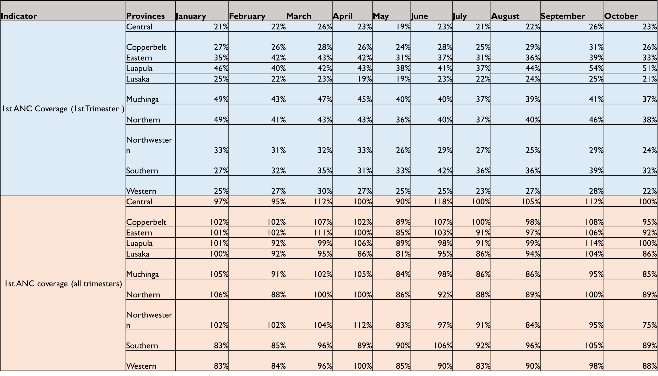
1st ANC coverage by Province from Jan 20 to Oct 20
Central has the lowest 1st ANC Coverage (1st Trimester) around 21% on average
Luapula has the highest monthly 1st ANC Coverage (1st Trimester) at 43%

Slide 5
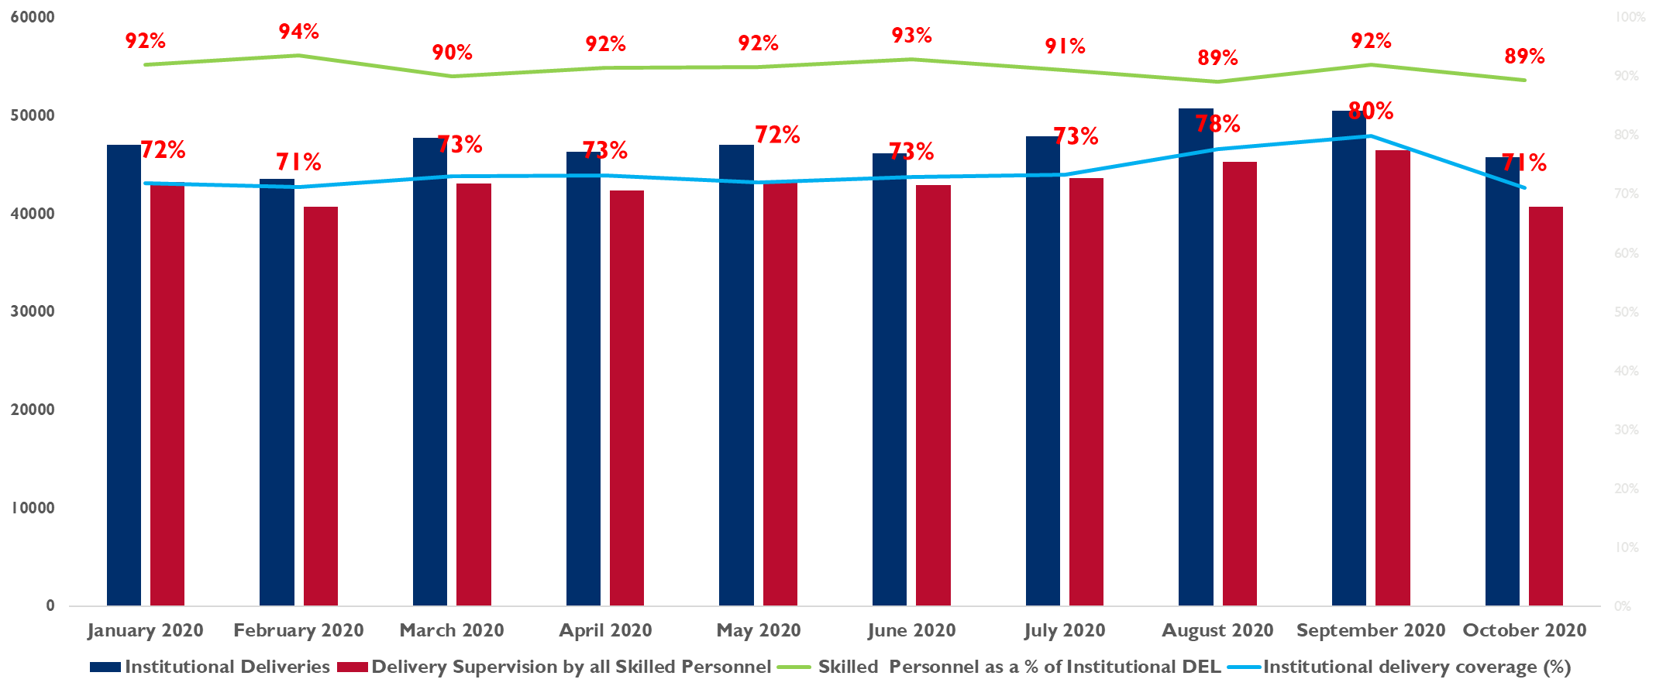
Proportion of Institutional Deliveries and Deliveries supervised by skill staff for 2020
On average Institutional deliveries has been around 91%
Deliveries supervised by skilled personnel as be around 74% on average
No apparent attribution of COVID-19 to Institutional Deliveries coverage
Notes:
-The green line is challenging, please change color
-While I like what is being shown here, it seems overly complicated and that the line graph showing percentages would be more valuable than the number of deliveries. The number of deliveries are so high that you can’t even really read the value on a bar graph anyways and this information may be more clear in the table or a data set linked to the graph.
-Again, I think this needs a comparison outside of 2020. It doesn’t seem that we can say there is not apparent contribution to COVID-19 when all the data is from 2020. Other data I have seen shows decreases in 2020 compared to 2019 which could be linked to factors such as the gassings, COVID-19, etc.

Slide 6
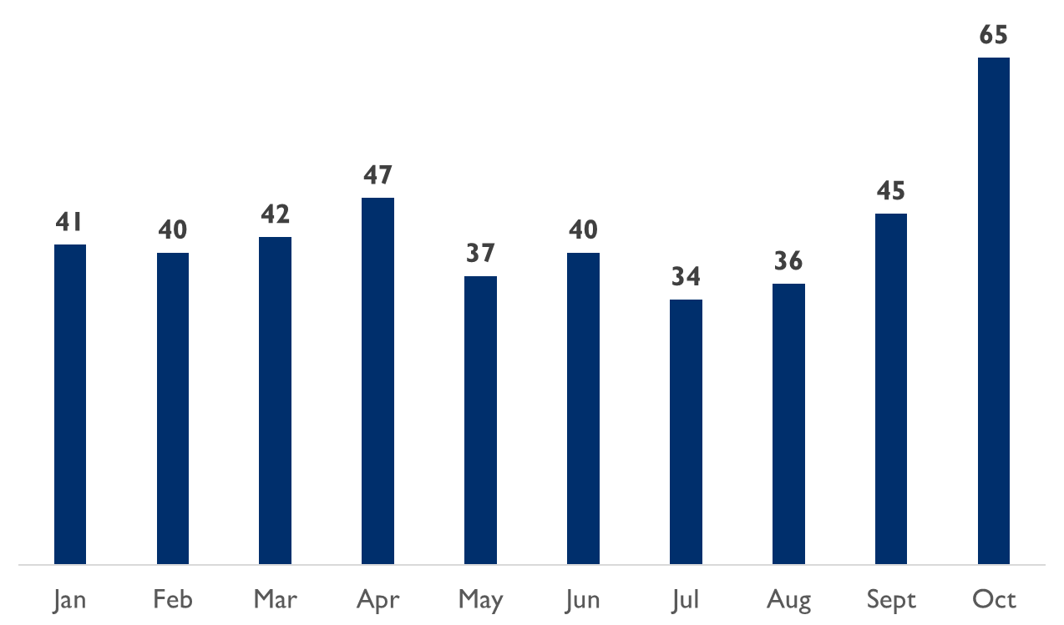
Number of Maternal Deaths from Jan 20 to Oct 20
Average of 43 Maternal deaths from Jan 2020 to Oct 2020
Highest was in Oct 2020 with 65 and lowest in Jul 2020
The common causes of maternal deaths is obstetric hemorrhage (PPH), hypertensive disorder, abortion outcomes and sepsis, malaria, HIV and anemia.
Minimal apparent attribution of COVID-19 to maternal deaths
Discussion point
Measures employed to reduce maternal deaths
Intensified review of all cases as and when they occur in order to learn and prevent further occurrences in the future
Emergency preparedness by ensuring that facilities are stocked with the necessary emergency obstetric equipment and supplies
Redistribution of midwives so that pregnant women are guaranteed of quality obstetric care
Promotion of early referral at both community and facility.
IEC on the benefits of early ANC booking and having to attend atleast four ANC visits
Notes:
-Any indications as to why October was so much higher? Is this a nationwide trend, linked to a few provinces, a potential data error, an increase to a certain cause, other?
-While we did not request for it within this data, it would be helpful to have causes of death (maternal, newborn, etc.) in the data model.
-Could you please provide more details on the “measures employed to reduce maternal death”? Are these things the MOH is promoting right now, your suggestions, other? How do these points link to the data? For example, is data showing that distribution of midwives is an issue that is leading to maternal deaths? Mainly, just trying to get an idea of what this box is trying to show.

Slide 7
Maternal Deaths trend from Jan 2018 to Oct 2020
Notes:
-This visual is hard to read and visually messy. It needs to be redone.
-This data does not appear to match what is in the excel spreadsheet. I added everything up in both and they are quite off. Is this one maternal deaths and the other maternal deaths in facility? Please explain why the data doesn’t match up. This is also an example of how having the definition within the slide or in the comment box would be very helpful in reducing confusion. As a real-life example, I was trying to use this data yesterday for a report and spent a few hours just trying to confirm what was meant here by “maternal deaths” compared to the excel table. This should have been very easy, but it was a wasted effort as I couldn’t get the figures to match so could not be sure if how I was describing the data and the indicators was accurate.
-Thank you for including trends from a couple of years.

Slide 8
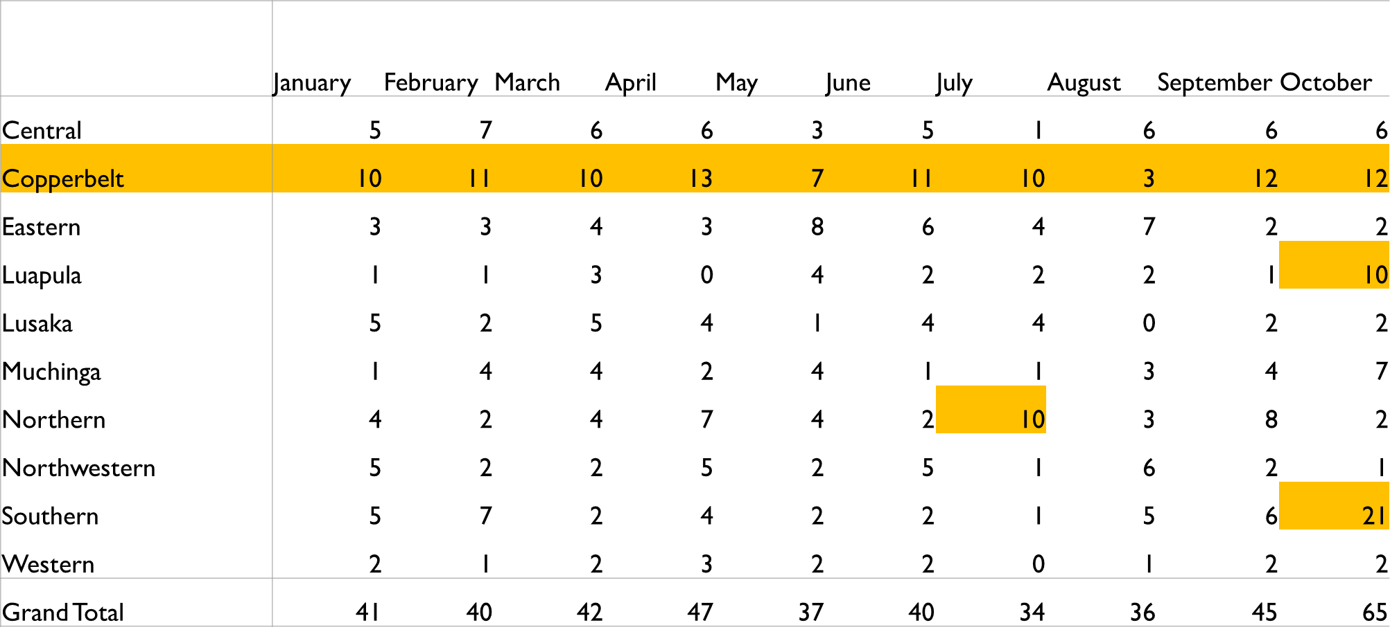
Number of Maternal Deaths from Jan 20 to Oct 20
Notes:
-Any indications as to why Southern may have been so high in the month of October? Same comment for Luapula and Northern standouts.
-I noted you highlighted Copperbelt complexly as being the highest. Any indications of why this may be the case? Is it a matter of population, data issue, something else?
-Is the Women and Newborn Hospital (located in Lusaka) captured in this data?

Slide 9
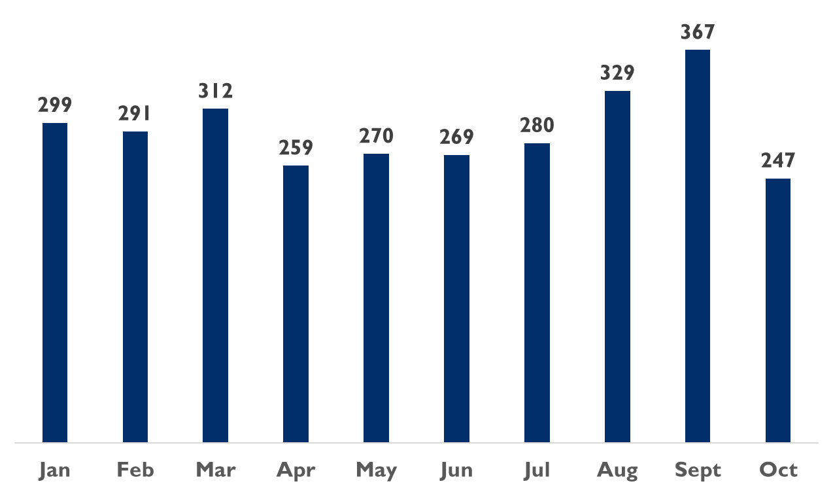
Neonatal Death from Jan 20 to Oct 20
Sept 2020 recorded the highest number of Neonatal deaths
Oct 2020 recorded the lowest number in Neonatal deaths
Average number of Neonatal deaths 292 per month
Discussion point
Measures employed to reduce neonatal deaths
Training and mentorship in essential newborn care for facility staff is still top of the agenda
Early referral of cases from facility to specialized health care
Intensified Review of cases to increase knowledge and understanding in order to prevent future occurrences
Intensified case surveillance for early detection of cases at all levels
Notes:
-Same comments/questions as slide 6, but in relation to neonatal deaths.
From E4H
The Neonatal death Jul (221 and Aug 248) when analysis was done in Oct
Late update of data is a big challenge

Slide 10
Neonatal Death from Jan 2018 to Oct 2020
Notes:
-This visual is hard to read and visually messy. It needs to be redone.
-Thank you for including trends from a couple of years.
-Perhaps the title can reflect the trend. It seems deaths on average have been increasing from 2018 to 20

Slide 11
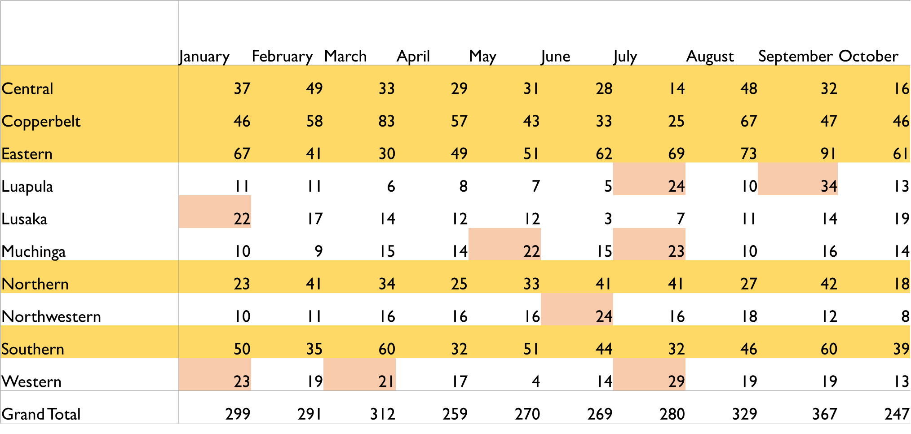
Neonatal Death from Jan 2020 to Jul 2020
Notes:
-Please provide a key to indicate what is meant by the different highlight colors
-Is there a way this could be presented visually without being too crowded? If monthly is to much, perhaps quarterly or comparing a few years.
-If available, please provide any insights on the highlighted cells.
-Is the Women and Newborn Hospital included within this data?
-Title is incorrect and should be updated.

Slide 12
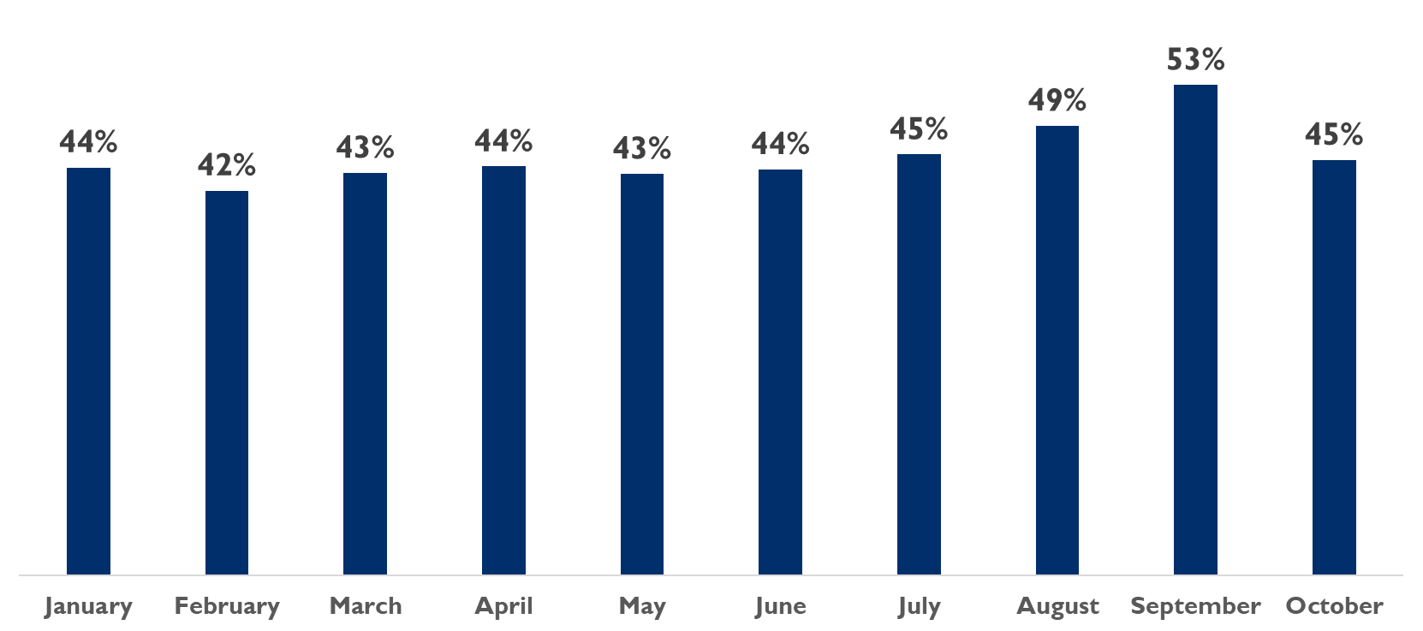
Maternal postnatal care within 48 hours after delivery (%) for 2020
No apparent attribution of COVID-19 to Postnatal care coverage
Notes:
-As stated elsewhere, please provide calculations or link to data
-I am not sure 2020 data is enough to show no apparent attribution as gassings/COVID-19 have impacted nearly all of 2020. This would be more helpful with other years as comparison.
-Also, it is helpful to see this data for provinces too. See other slides for where I referenced reasons why more than just national is needed.

Slide 13
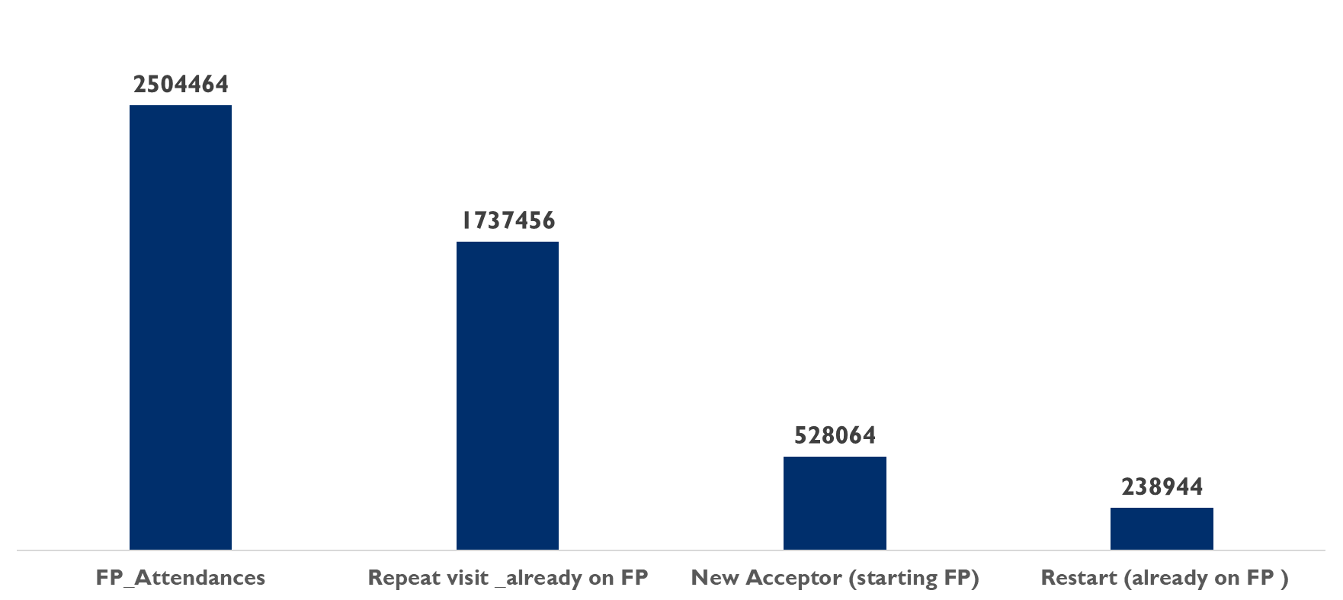
Family Planning Uptake from Jan to Oct 2020
69%
21%
10%
More than 50% of the FP attendees are repeat visit with on 21% being new acceptors in the 10 months
No apparent attribution of COVID-19 to Postnatal care coverage
Notes:
-The last bullet speaks of postnatal care, not FP
-Same comment on attribution as last slide
-Should it be “restart (already on FP)” or “restart (previously on FP)”. I am not sure if there is a commonly used term or not.

Slide 14
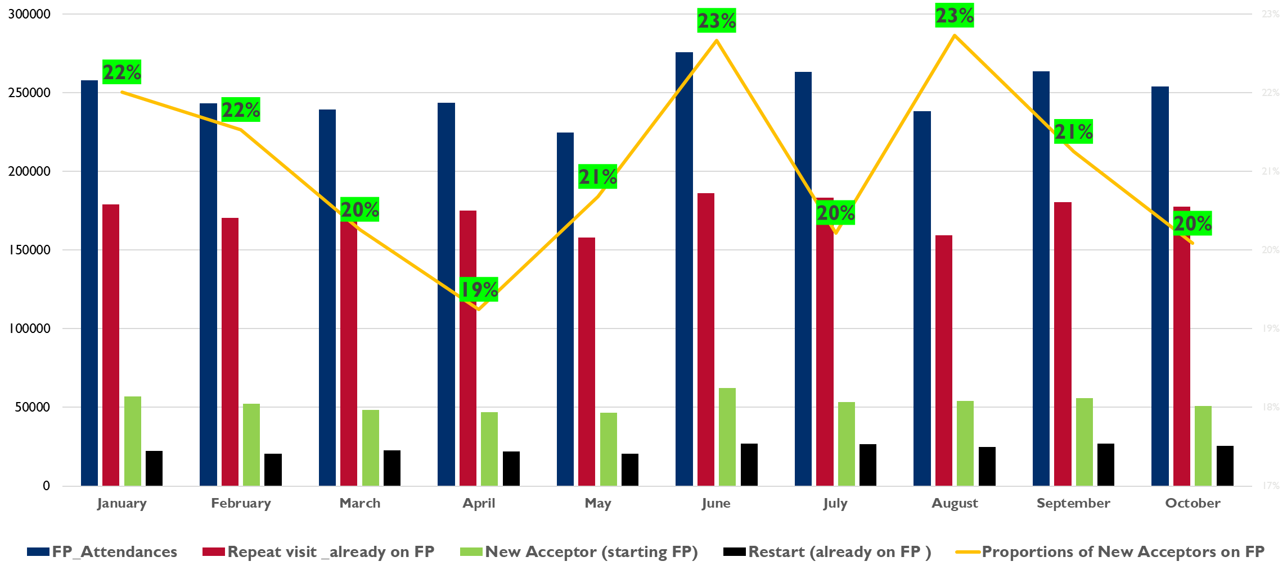
Monthly Family Planning Uptake from Jan20 to Oct 20
Notes:
-This slide is hard to read, especially the jarring green highlighted figures

Slide 15
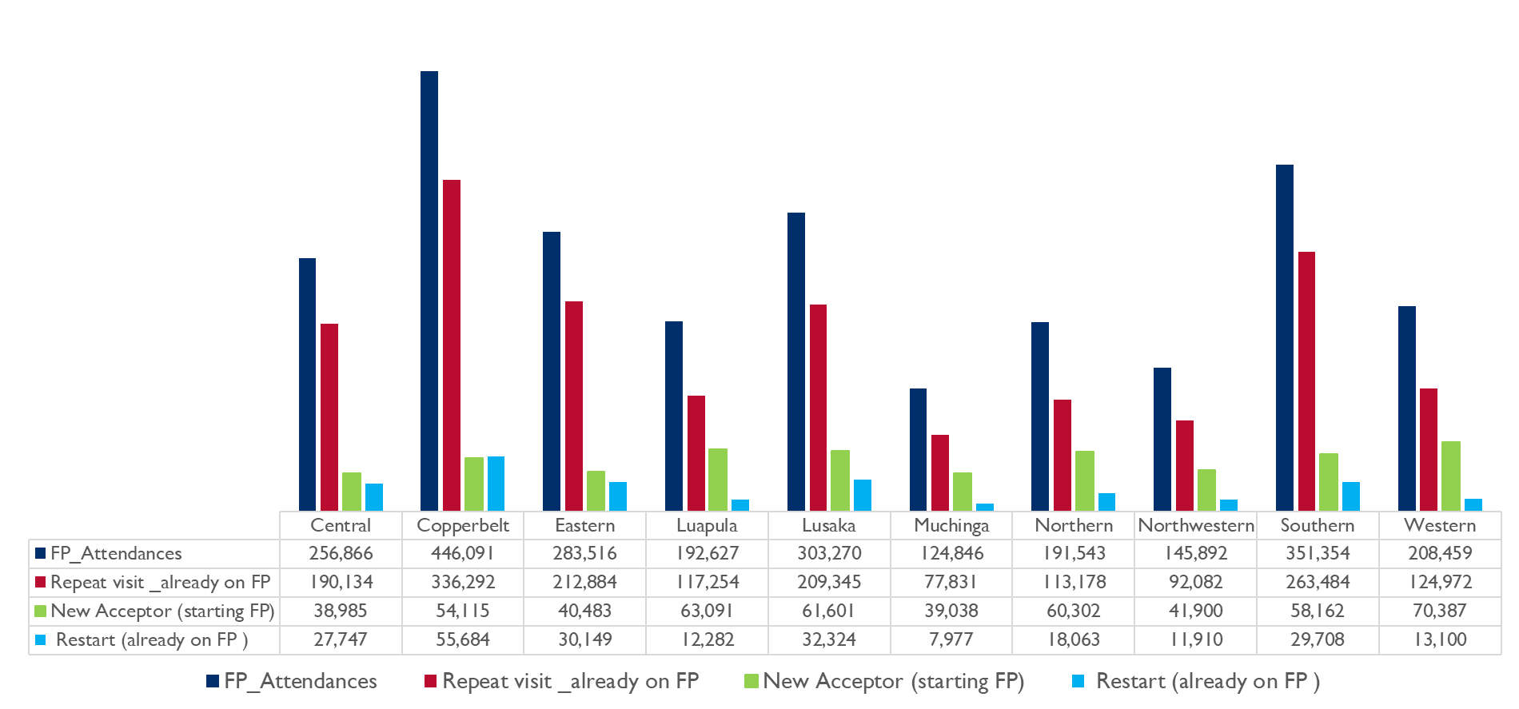
Family Planning Uptake by province from Jan20 to Oct 20

Slide 16
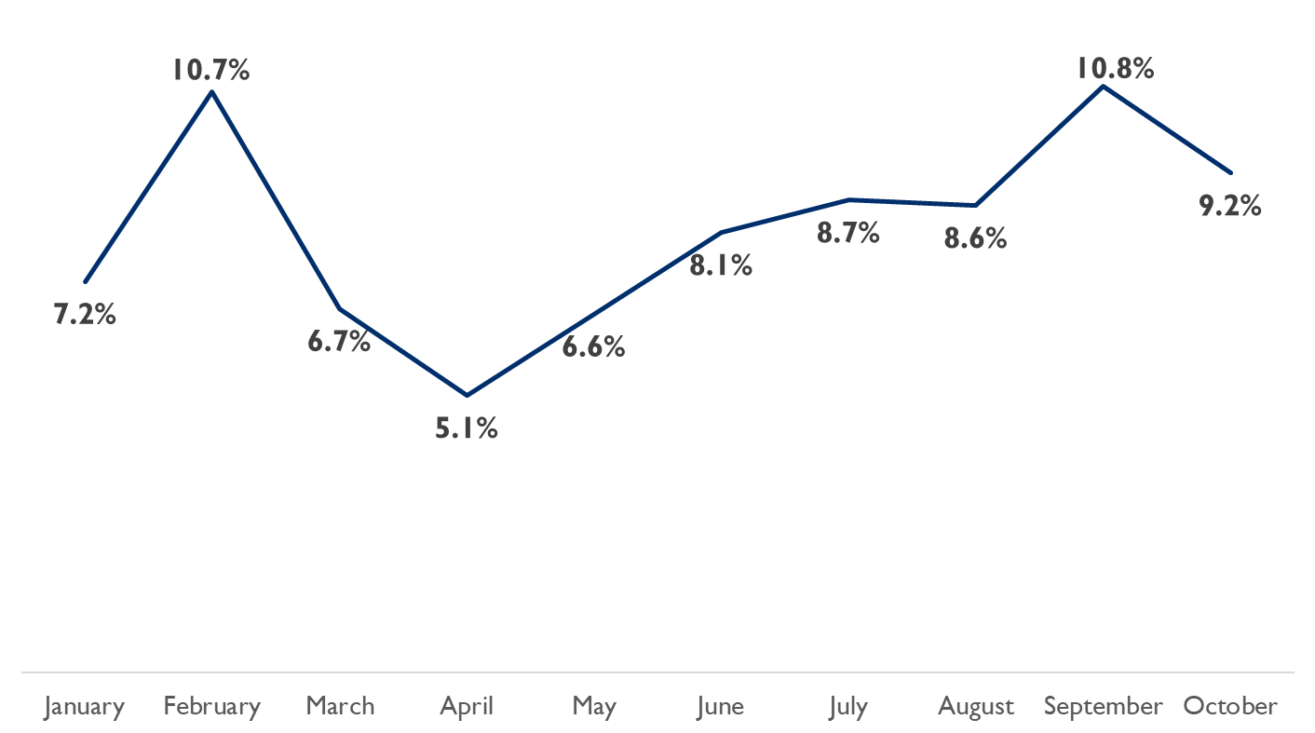
Proportion of clients accessing long-acting reversible contraceptives in 2020
Uptake of LARC not affected by COVID-19
Measures were put in place to sensitize communities about the availability of FP services at HFs amidst COVID-19 pandemic
Notes:
-Please provide more details on where the info in the second bullet is coming from
-Is the second bullet indicating that dips may be/are related to supply chain challenges?

Slide 17
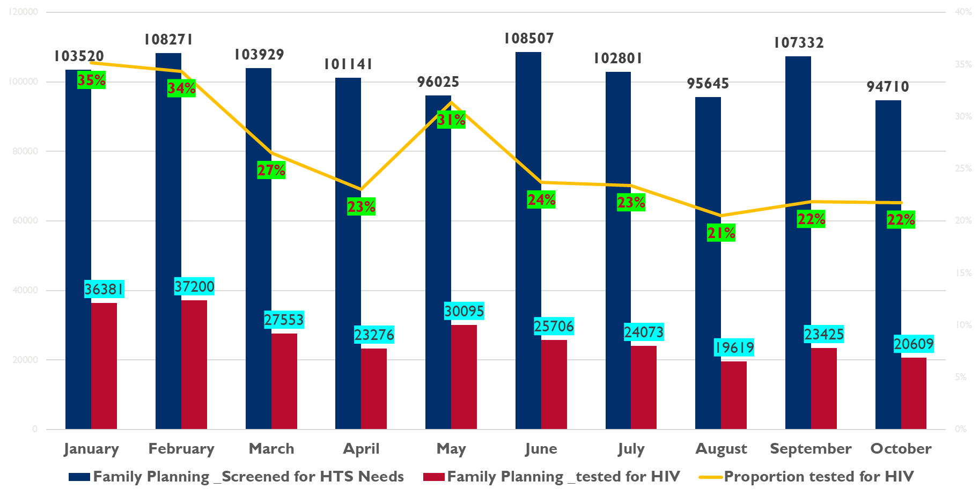
Proportion of FP clients Jan to Oct 2020
Notes:
-Please do not use red and green together in one box as it may be hard for people who are colorblind and is not 508 compliant
-The title seems to be missing additional information could you kindly see how the information in the legend could adequately be reflected in the title

Slide 18
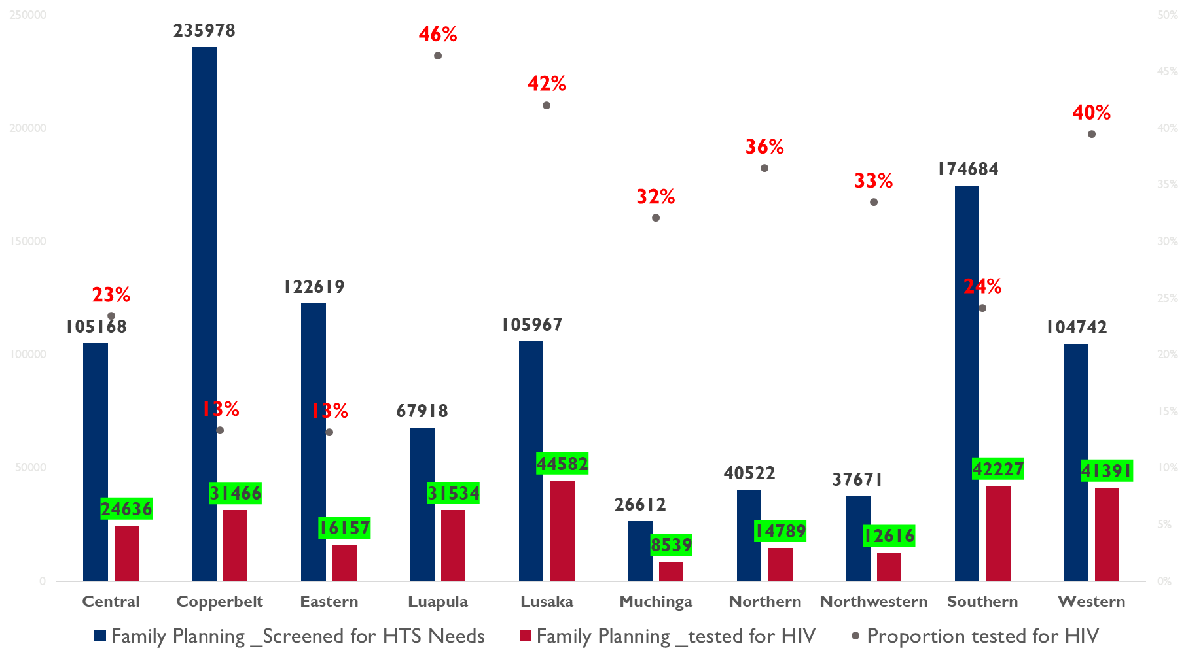
Proportion of FP clients by province Jan to Oct 2020
Notes:
-This graph is a little complicated and takes some time to understand. I am not saying everything needs to be simple, but the simpler things can be the better.
-Is there supposed to be a line connecting the dots like in the previous slide?
-The title seems to be missing additional information could you kindly see how the information in the legend could adequately be reflected in the title

Slide 19
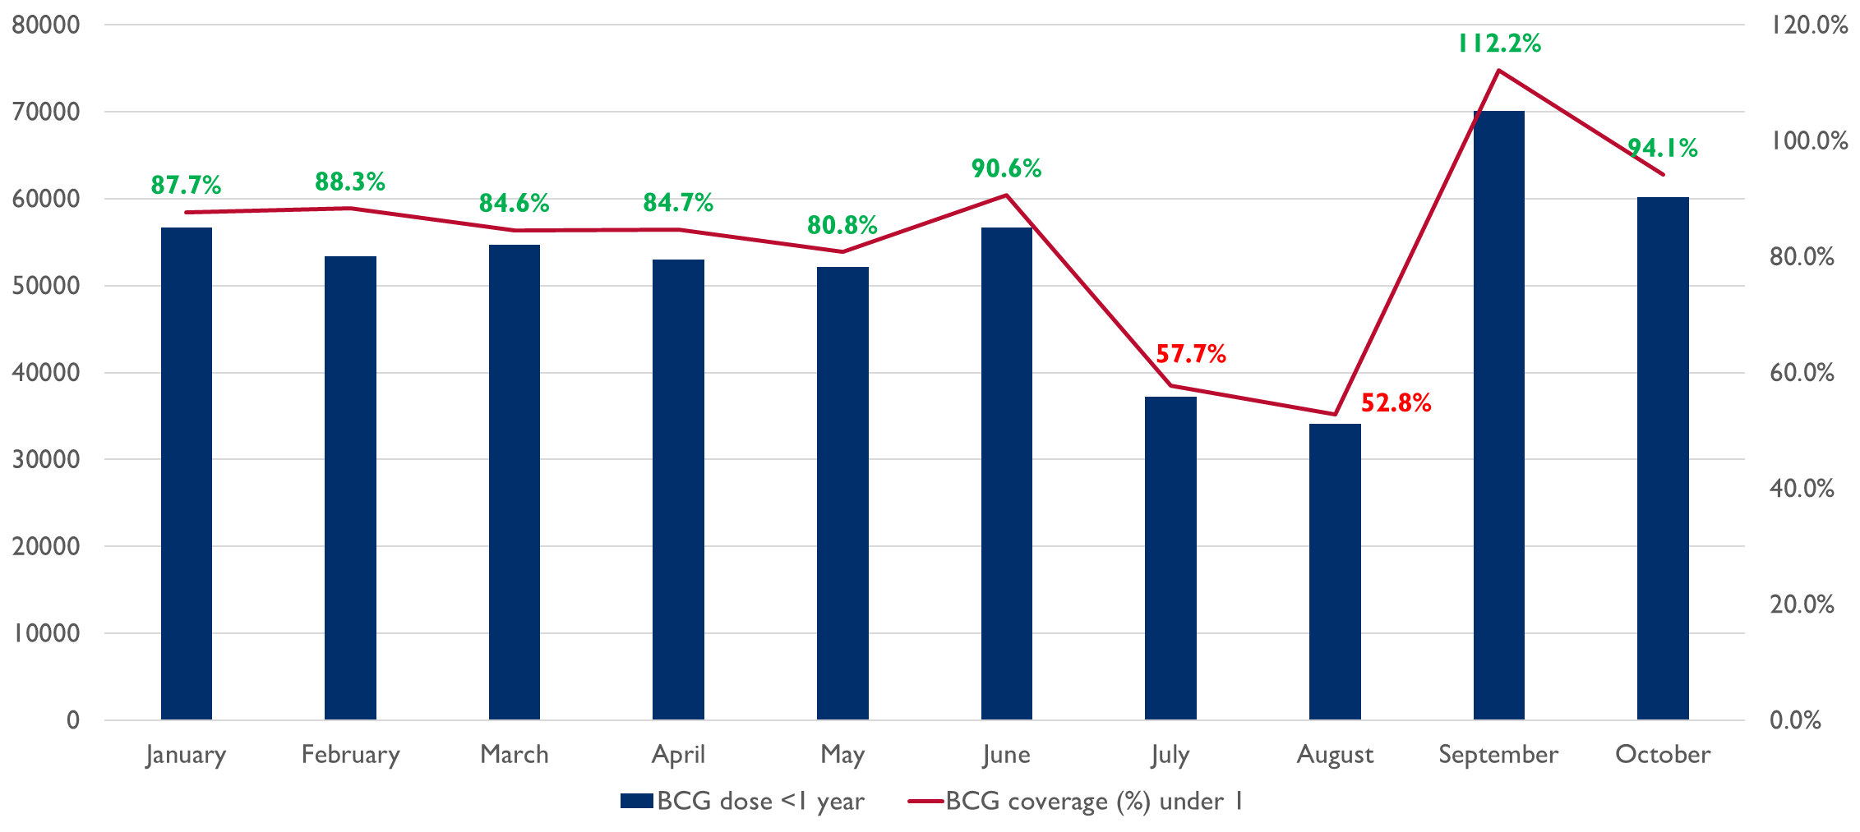
BCG coverage (%) under 1- Jan to Oct 2020
Jul and Aug 2020 recorded the lowest BCG coverage
Sept 2020 recorded the beyond 100% coverage This is due to Lusaka, Eastern and Copperbelt recording beyond there monthly average
Average BCG coverage is at 83.4%
Discussion point
There was some stockouts of antigens during the period under review
Mop up exercise was conducted in Sept hence the spike when the situation of having antigens normalized

Slide 20
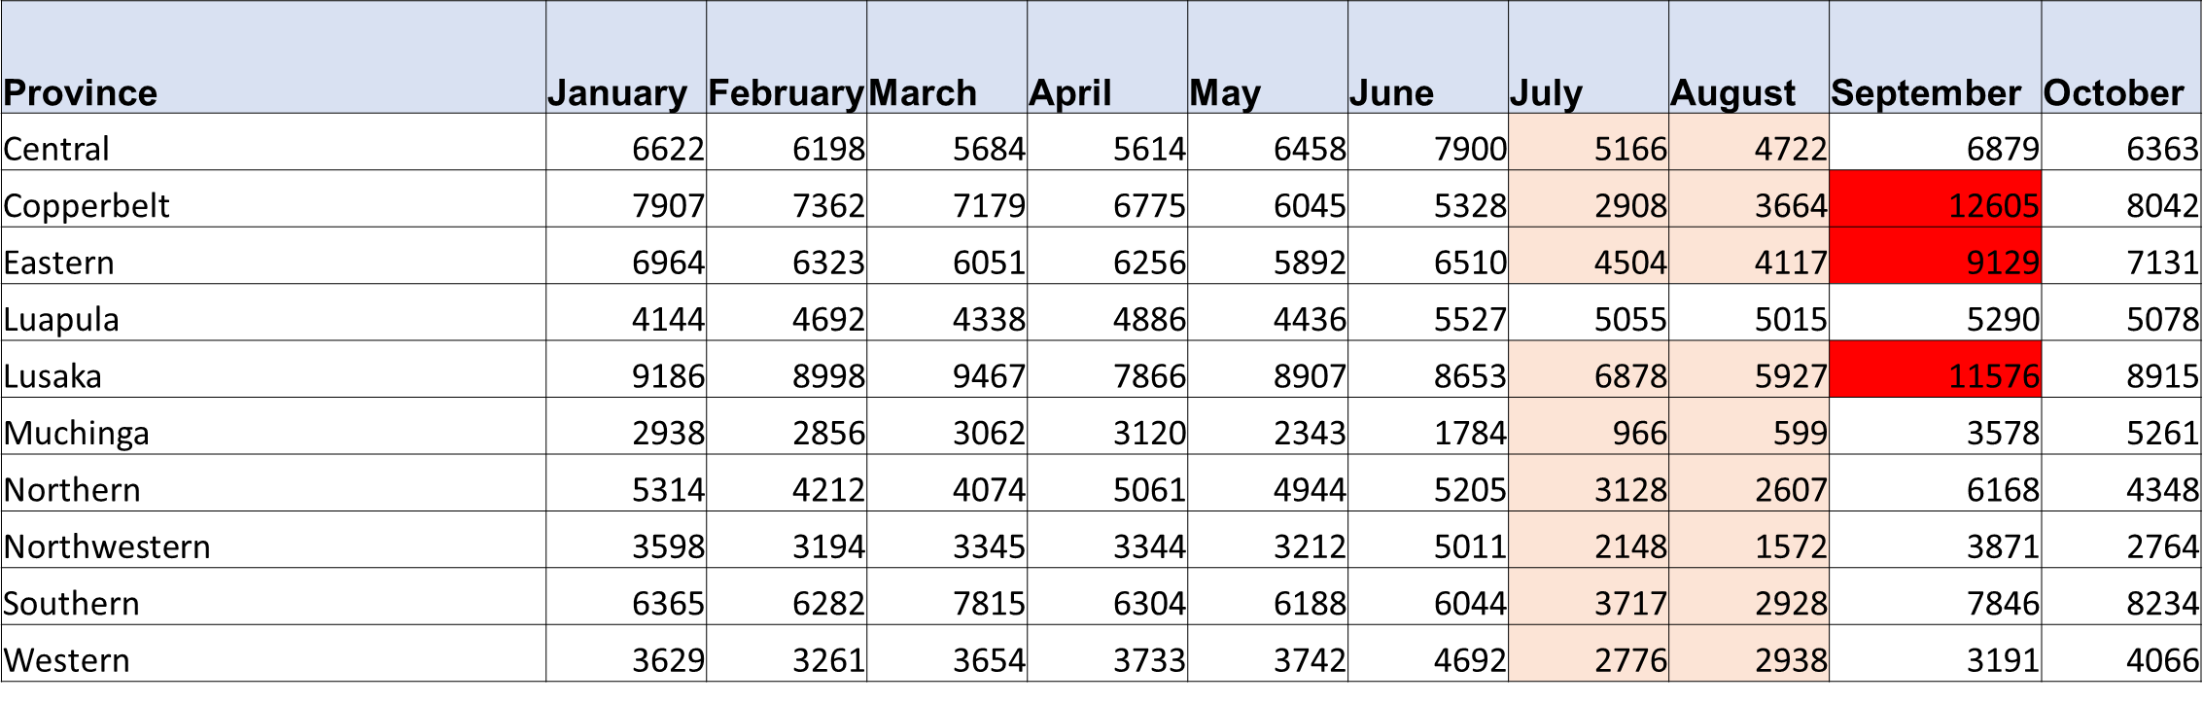
BCG Coverage (%) under 1- Jan to Oct 2020
Jul and Aug 2020 recorded the lowest BCG coverage across all districts in the 10 districts.
Sept 2020 recorded beyond 100% coverage. This is due to Lusaka, Chasefu, Lundazi, Nyimba, Chingola, Kitwe, Luanshya, Mpongwe, Mufulira and Ndola recording beyond there monthly average
These districts were affected by the stockouts of antigens hence conducted mop up activities
Discussion point
There was some stockouts of antigens during the period under review
Mop up exercise was conducted in Sept hence the spike when the situation of having antigens normalized
SHIOs engaged to monitor the accuracy reporting of data from facilities

Slide 21
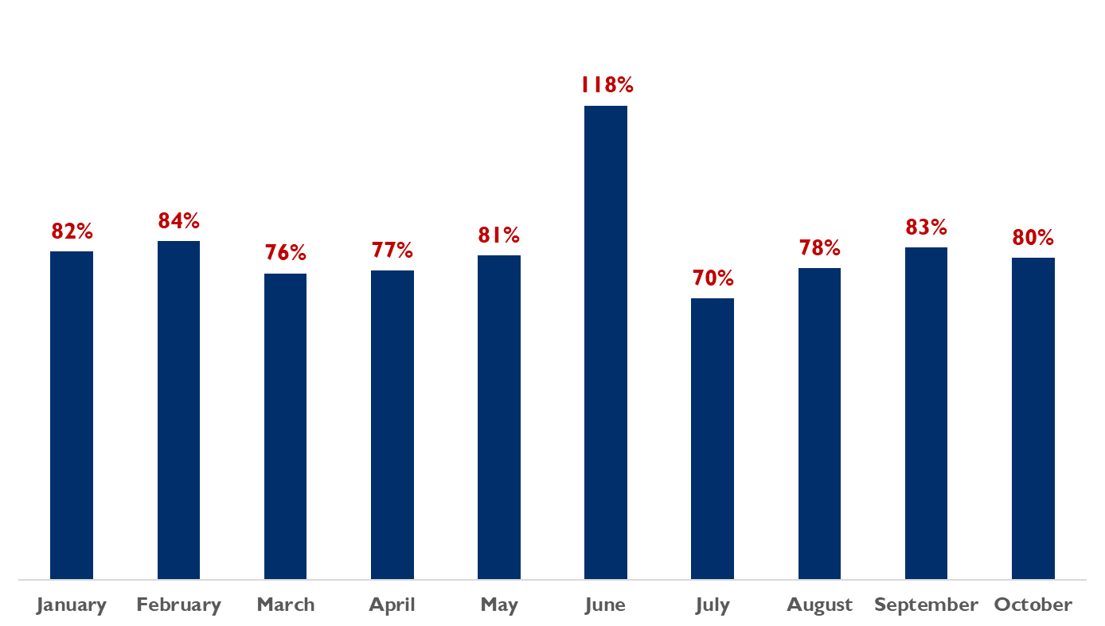
Fully immunized coverage (%) under 1 for 2020
Discussion point
There was some a huge spike in June, as it is a month mainly used for child heath campaign.
Districts oriented not to combine routine immunization data with survey data (campaign data)
Lusaka and Central almost double there monthly average in June, data cleaning and validation still ongoing in the affected districts
SHIOs engaged to monitor the accuracy reporting of data from facilities
Notes:
-Type in third bullet

Slide 22
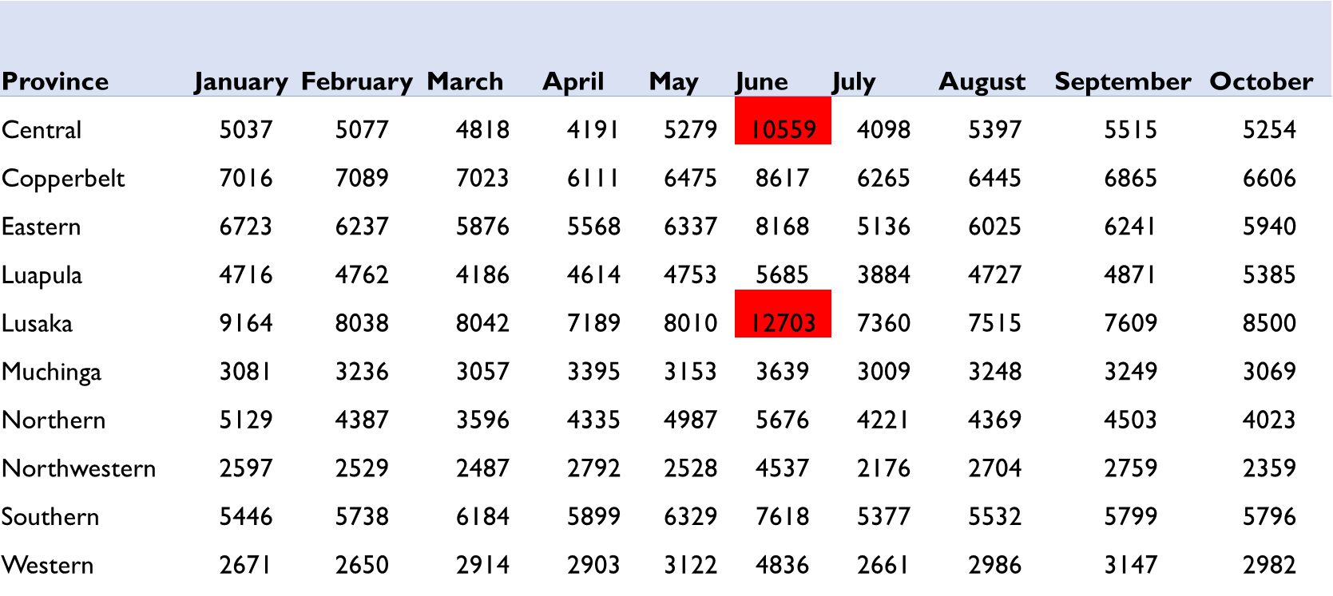
Fully immunized under 1 for 2020
Discussion point
There was some a huge spike in June, as it is a month mainly used for child heath campaign.
Districts oriented not to combine routine immunization data with survey data (campaign data)
Lusaka and Central almost double there monthly average in June, data cleaning and validation still ongoing in the affected districts
SHIOs engaged to monitor the accuracy reporting of data from facilities

Slide 23
Next steps
Monthly data reviews - address the completeness, timeliness and consistency
pull all the monthly data soon after capture,
provide feedback to HFs and program managers,
identify challenges and come up with interventions that we will agree to resolve identified challenges
Quarterly DQAs – address data accuracy
Ensure that DQA data is captured into the HMIS
Data for Action and Help Desk – issues identified, captured and tracked
Actions agreed to be documented in the HMIS and tracked until resolved
Refinement of Meta data – dashboards and analytics designed for each level (HF, DHO, PHO, National) and each program
Notes:
-I would like to suggest that the next steps be divided up by who they should be done with or by (MOH, USAID/Zambia FH Team, E4H alone etc.).
-As a next step, I would like to suggest a meeting in early January to discuss comments in this slide deck. This would be a small meeting with select members of the USAID/Zambia team. Following this meeting and some data clean-up, I would like to tentatively suggest an interactive data review with the FH team. We can discuss what this may look like during the internal meeting.

Slide 24
Next steps
Support capacity building for program officers in the supported provinces (Central, Copperbelt, Luapula and Northern) and through TWG engage MoH to lobby for support in the other provinces
Continuous engagements with Senior Health Information Officers (SHIOs) across the country to address data quality
Strengthen mentorship at all levels to improve data use
Notes:
Additional Comments:
-Some past decks have included GIS maps, these were a nice and helpful visual
-Is there a reason why CFR for diarrhea was removed?

Slide 25

THANK YOU!
Contact Details:
USAID/Zambia COR: Arthur Kachemba
Email: akachemba@usaid.gov
E4H Chief of Party: Celia Kakande
Email: ckakande@msi-inc.com
Senior Advisor Knowledge Management, Data Demand and Use: Gift Sitenge
Email: gsitenge@msi-inc.com

